Slide 1

Scoring & Ranking

Slide 2
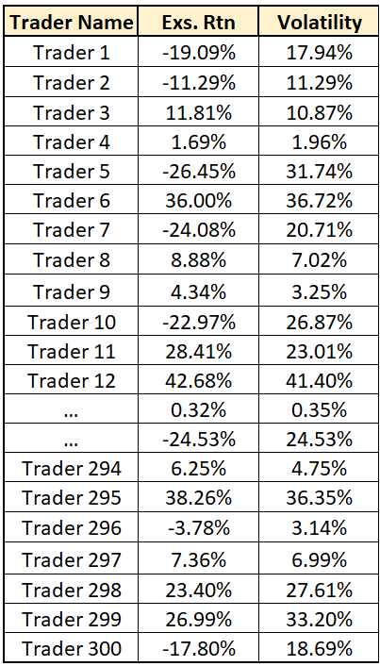
Step 1:
Calculate Excess Return and Volatility for each trader in the competition.
Performed daily as data are available
Based on end-of-day Net Asset Value (NAV) starting on 01 Oct 2023
Excess Return is defined as

